Slide 1
Hosting Projects with Open Mainframe Project

Slide 2
Mission of the Open Mainframe Project:
Build community and adoption of Open Source on the mainframe
Eliminating barriers to Open Source adoption on the mainframe
Demonstrating value of the mainframe on technical and business levels
Strengthening collaboration points and resources for the community to thrive

Slide 3



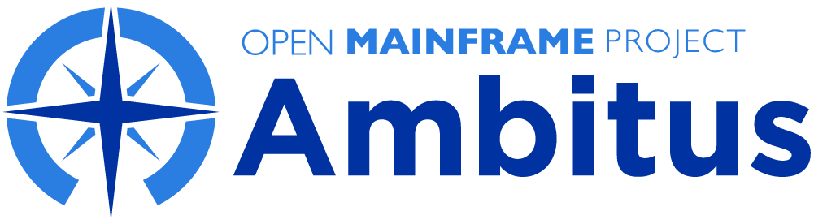
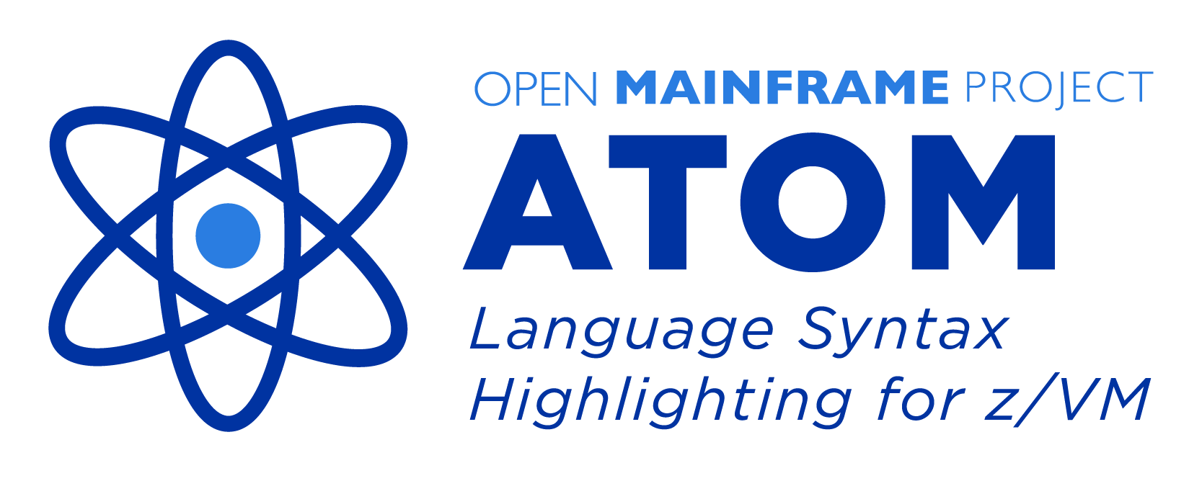




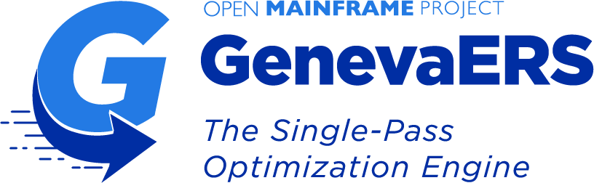

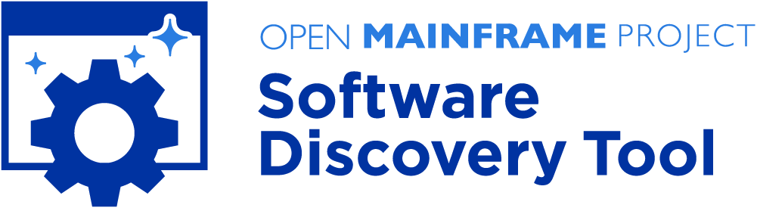

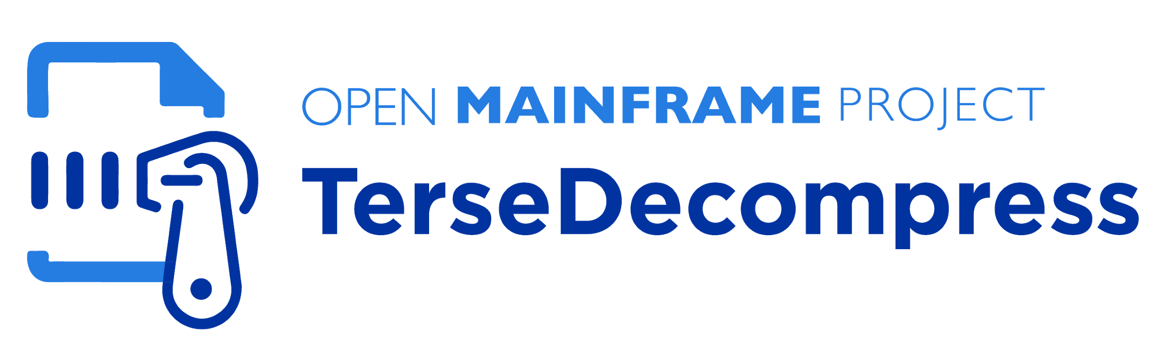
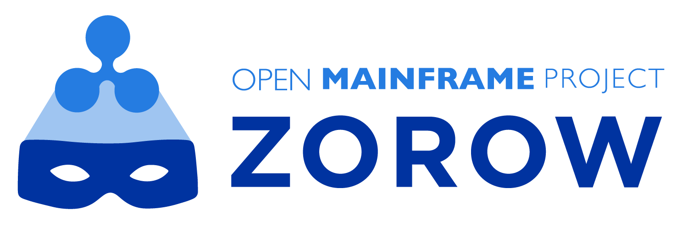
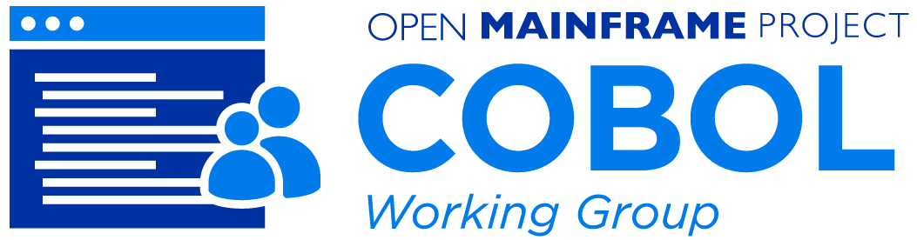
Creating spaces for mainframe community open source collaboration
Active Projects
Incubation Projects
Working Groups
Learn about all Open Mainframe projects at https://www.openmainframeproject.org/projects

Slide 4
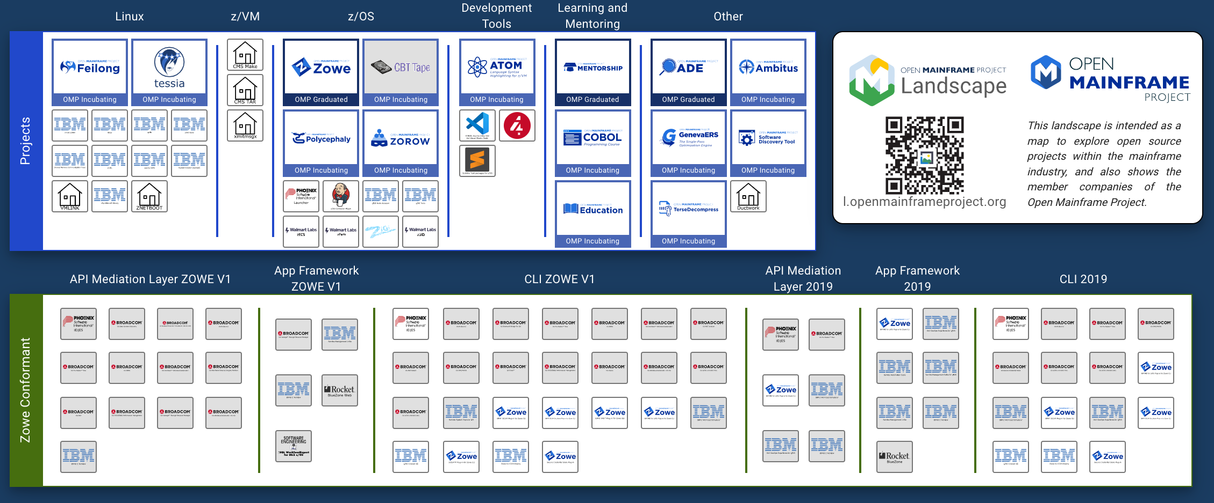

Slide 5
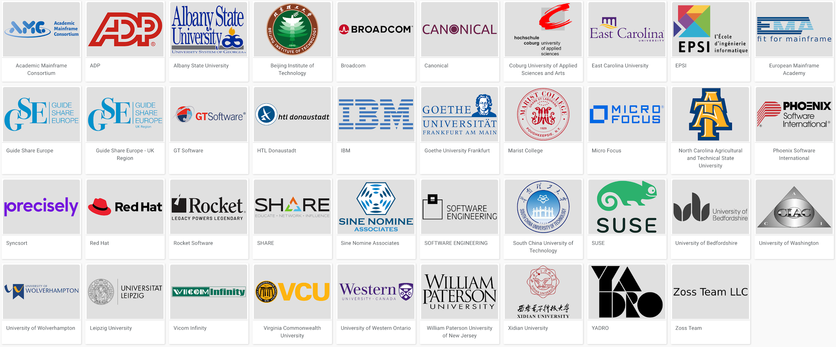
5 years since launch | 39 Supporting Organizations | 16 Hosted Projects and Working Groups | 40+ Mentees Sponsored | 300+ Project Contributors | 30,000+ Project Contributions

Slide 6
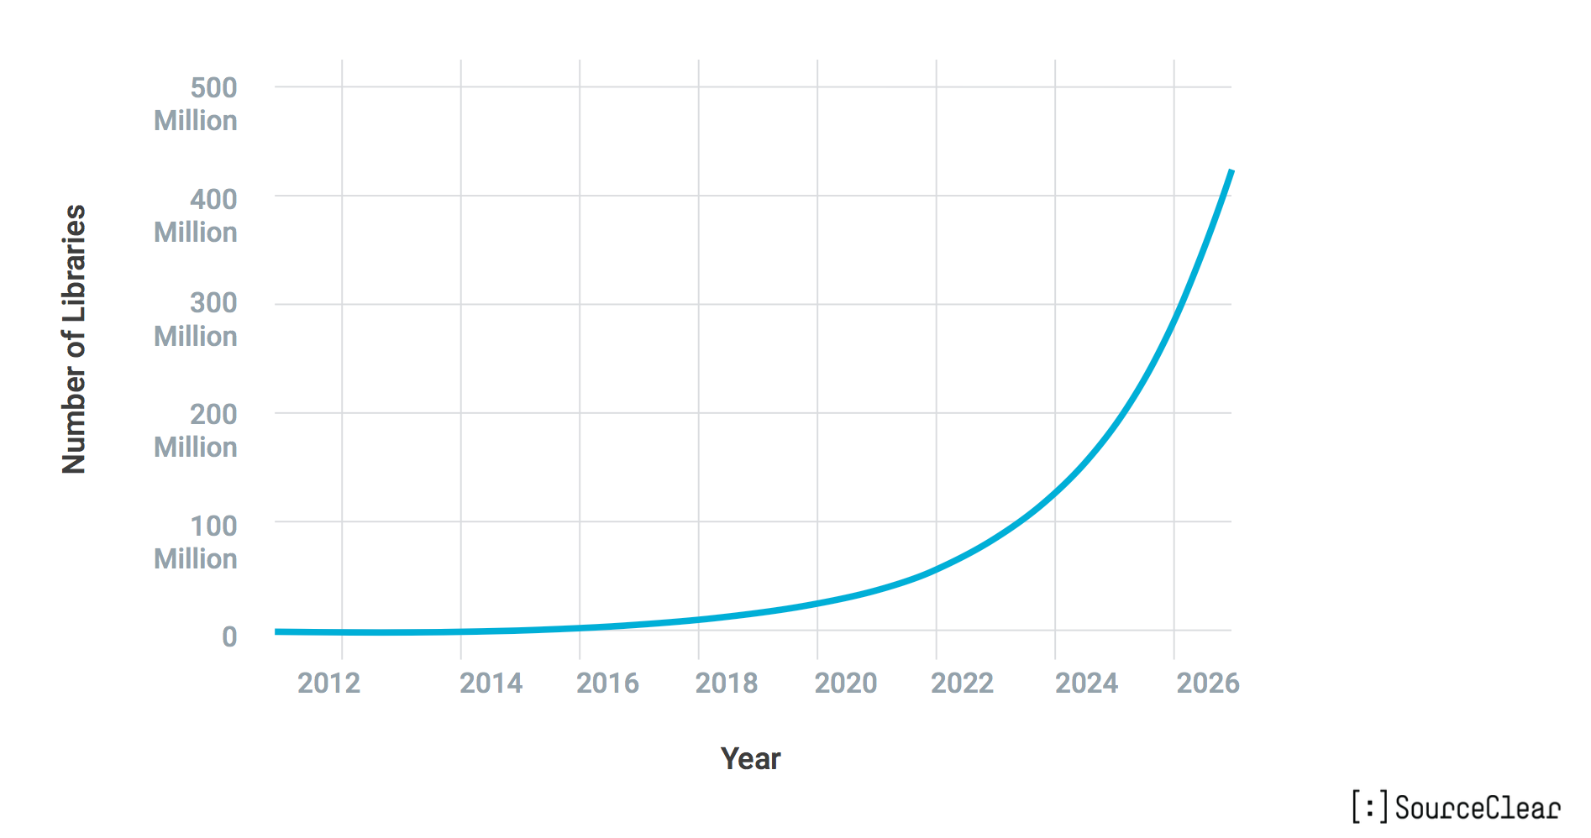
Open Source Isn’t Slowing Down Any Time Soon

Slide 7
The Real Question is Which Projects Matter?
Value of of Individual Project
Number of Open Source Projects

Slide 8
LF seeks to accelerate new projects to adoption and sustainability
Value of of Individual Project
Build Ecosystems
Number of Open Source Projects

Slide 9
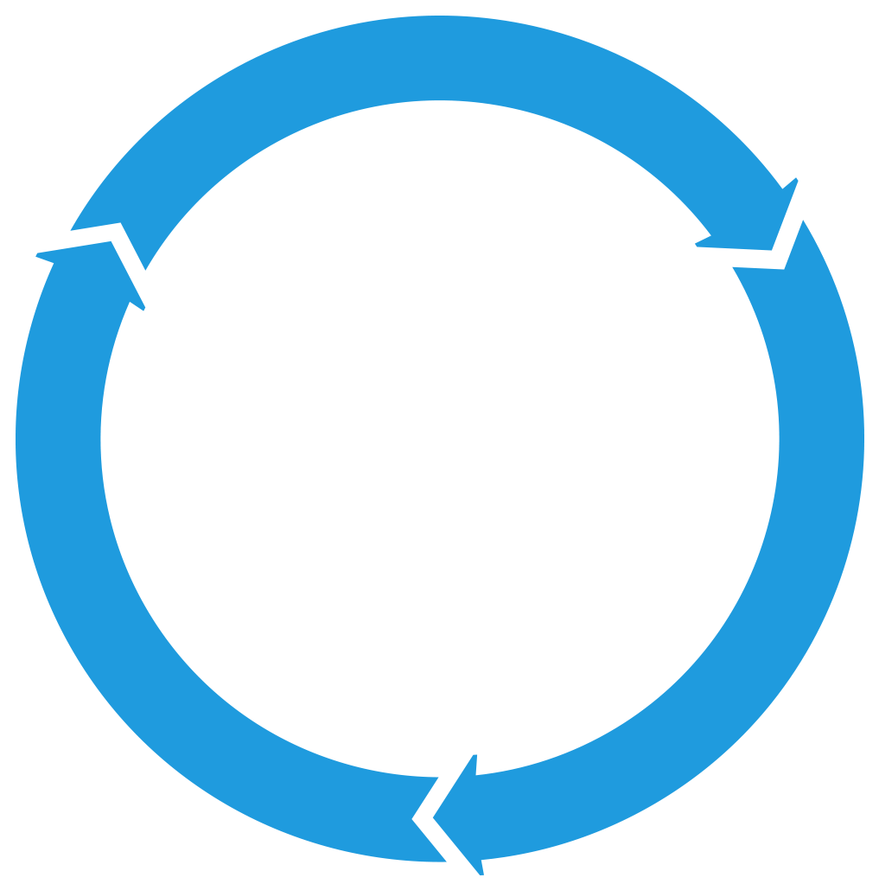
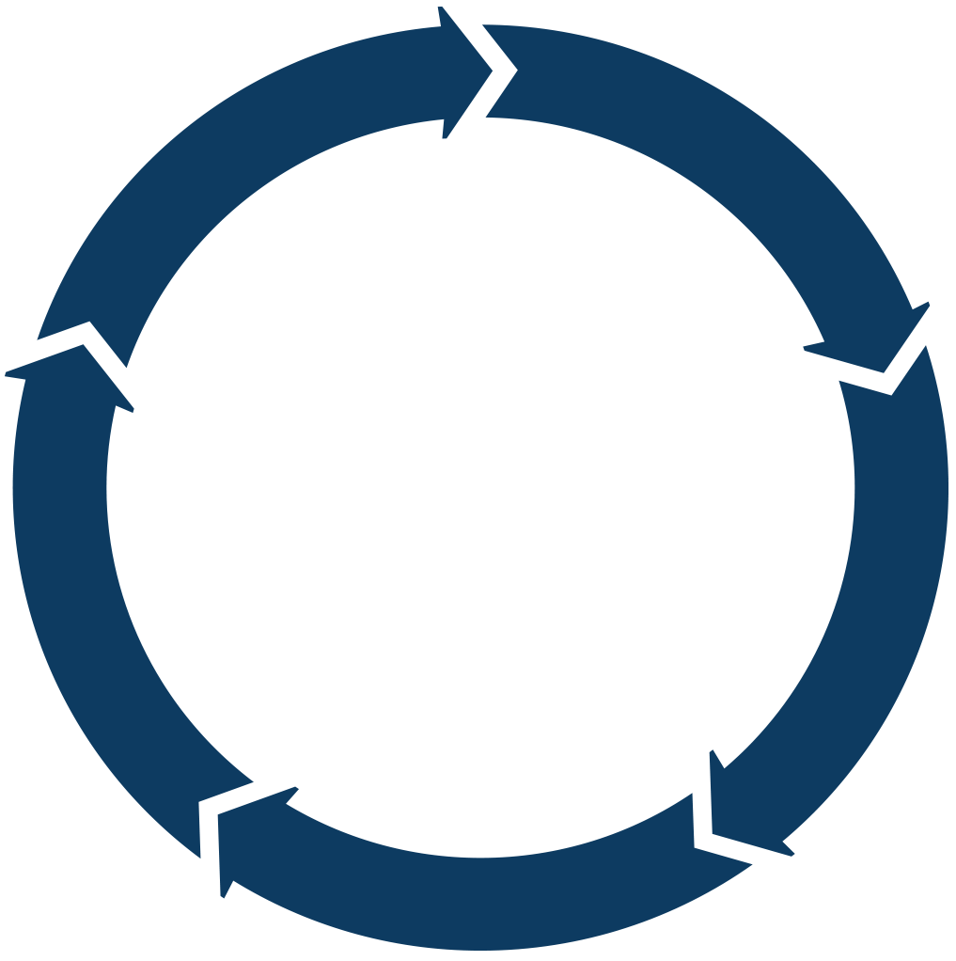
The Answer: Projects With Sustainable Ecosystems
PROJECTS
Sustainable projects have a developer community whose technology is used in commercial solutions that profit businesses, who in turn participate and reinvest back into the project and hire developers to work in the community.
DEVELOPER
COMMUNITY
TECHNOLOGY
PARTICIPATION
PRODUCTS
PROFITS
MARKETS
PRODUCTS

Slide 10
Open Source on Mainframe - Ecosystem Challenges
Glass ceiling for project investment and adoption
in the absence of a fair governance and safe haven for the project’s assets
1
Managing projects assets
As project grows, it is unclear who should own legal and administrative tasks that are essential to the health of the project
2
Developed for a specific product needs
The open source spinoff is a result of wanting to build an ecosystem and collaborate on building a platform
3
Governance challenges
No formal governance,
governance favors the creators of the project,
project backer dominating dev and governance
4
Fragmentation
Lack of integration
Lack of cross pollination across projects
5

Slide 11
Creating sustainable open source projects requires real work
Governance and Membership
Incorporation, Tax status, Bylaws, Member Agreements, Anti-trust, etc.
Ongoing business development and membership recruitment
Development Process
Technical Decision Making
Project Life Cycle
Release Process
Infrastructure
Custom infrastructure using open source best practices
Security and reliability
Ecosystem Development
Marketing
Events
Training
IP Management
Code Provenance and License compliance
Trademark management
Legal defense and Collaboration

Slide 12
Case Study: Zowe
Open Mainframe Project focuses on projects that matter
Major Problem
How OMP Innovated
Results - 2020
Value of of Individual Project
Modernize integration with z/OS based applications and services
Bridge the talent gap by enabling modern development stacks on z/OS
2018 Open Mainframe Project added Zowe
2019 Zowe reached 1.0, launched Zowe Conformant to enable downstream ecosystem
Investments in collaboration, ecosystem development, and infrastructure
20000+ Commits, 200+ committers
Zowe gaining significant mindshare in DevOps community
20+ Zowe Conformant offerings
Number of Open Source Projects – Millions on Github

Slide 13
Why host your project at Open Mainframe Project?

Slide 14
The LF is the leading commons for community assets
The LF is the largest open source foundation, providing management of community assets for over 400 projects:
Over 3,400 source code repositories.
Over 700 trademark registrations and applications, plus hundreds of unregistered marks.
Over 700 project domains and DNS records.
Over 12,000 Contributor License Agreements signed for project communities that decide to require one.
Neutral sponsorship for managing fundraising.
Over 1,600 unique member company relationships.
Our communities raised over $100 million in 2019 via over 6,500 invoices.
Our communities spent funds in over 180,000 separate transactions in 2019.
The LF reports its audited financials to its board.

Slide 15
Building an ecosystem around open source projects
The LF has repeatedly shown its ability to build diverse ecosystems around open source projects incorporating developers, end users, tech giants, consulting companies, and startups.
The LF hosts Let’s Encrypt, which provides the majority of the world’s https certificates, and demonstrates our track record of helping to build sustainable, privacy-focused initiatives.
The LF has a strong history of fostering a rich environment of downstream commercial and volunteer implementations.
There are hundreds of independent Linux distributions.
There are over 100 Certified Kubernetes implementations, each of which has passed a comprehensive conformance test suite.
CNCF has achieved unprecedented success in helping to grow awareness and adoption of Kubernetes, as demonstrated by Google Trends and KubeCon attendance.

Slide 16







Building large, sustainable ecosystems requires collective resources
Events
Legal
Training
Certification
Developer Marketing
Developer Operations
Application Security
We gathered over 45,000 attendees from over 12,000 organizations across 113 countries in 2019.
We manage IP for the world's most important tech and have one of the world's top open source legal teams in house.
We have trained millions of students through free and paid online training, online skills certification, and on-site e-learning.
We have designed and implemented both software and hardware testing and certification programs.
We have the largest share of voice of any open source foundation and a proven method to build large scale developer programs.
We host the infrastructure that develops the world's largest software communities and provide release management, IT ops, and support.
In addition to massive peer review, our projects are regularly audited and pen tested. We offer bug bounties, dependency analysis, and code scanning.

Slide 17
What else can the Linux Foundation offer?
The LF is a recognized and respected brand and can activate communications across tech, business, and social media channels.
The LF runs one of the largest software training and certification organizations with millions of course graduates and hundreds of thousands of certified developers.
We can develop courses for AI, data, and analytics to train on using the apps and accessing the data.
We can also offer advanced courses for developers on integrating and customizing the upstream software.
The LF runs the largest developer conferences in the world. (Due to COVID-19, these have currently switched to being virtual conferences.)
The LF arranges third-party security audits, privacy policy audits, and bug bounties for our critical hosted software.
LF CommunityBridge offers paid internships with experienced mentors to increase the number and diversity of contributors.
Submission of protocols to become ISO standards via the LF’s Joint Development Foundation.
Hosting aggregated data projects, including via our Community Data License Agreement
Other services including documentation, webinars, PR, and much more, with many examples described in the CNCF annual report.

Slide 18
The Linux Foundation serves as a nonprofit home
The LF has invoicing relationships with its 1,600 members, representing nearly every significant tech company, hundreds of startups, and many government organizations.
We have strong relationships with all of the public cloud, mobile phone, and telecom organizations. For example, CNCF currently administers $9M in Google Cloud credits and $200k from AWS for our hosted projects.
The LF can quickly receive and distribute funding.
The mission of the LF, a 501(c)(6) nonprofit, is to support the creation of sustainable open source ecosystems and public health is a natural next focus.
The LF fee for fiscal sponsorship services, which includes audited financials, is 9% of the first million dollars per year and 6% of additional funds.

Slide 19
Question: Value of a Foundation?
There have been times when projects have asked what the value of an open source foundation can offer them?
A basic premise behind the LF, and open source in general, is that most interactions are positive-sum. There is no fixed amount of investment, mindshare, or development contributions that is allocated to specific projects. Just as open source development is based on the idea that, collectively, we are smarter than any one of us, open source foundations work to make the entire community better off. Equally important, a neutral home for a project and community fosters this type of positive-sum thinking and drives growth and diversity that we believe are core elements of a successful open source project.

Slide 20
Professional Services + Open Source Foundation
Open Mainframe Project provides a unique set of services for the mainframe community that goes beyond the simple mailing list, code repository, and website. You should host your project at Open Mainframe Project because:
Foundation
A neutral home for your project increases the willingness of developers from other companies and independent developers to collaborate, contribute, and become committers.
Endorsement by leading mainframe architects of the Open Mainframe Project’s Technical Advisory Council is an independent signal of the quality of your project.
Ability to leverage Open Mainframe Project mainframe infrastructure for your CI/CD needs.
You will have access to funds for further investing in your project, including security, training, and documentation
Partner academic institutions and next-gen students will have visibility into your project, resulting in new committers and class projects to help strengthen your project.
Your existing committers still control your project, and we just ask that you document a neutral governance process ( and if you don’t have one, we have one that’s a good starting point )
Staff
You can work with our full-time press relations and analyst relations teams to increase awareness of and excitement about your project.
Receive regular reports on press mentions and comparisons to similar projects.
Open Mainframe Project is able to leverage the expertise of its parent organization, The Linux Foundation, which hosts other successful projects including the Linux kernel, Let’s Encrypt, and Node.js. For example, Open Mainframe Project has worked on cross project collaboration between Kubernetes, HyperLedger, and Cloud Foundry for improving mainframe support of those technologies.
You will have access to full-time Open Mainframe Project staff who are eager to assist your project in myriad ways and help make it successful
Events
Your project will have unique opportunities to participate in our annual Open Mainframe Summit.
Our world-class events team work with you to showcase your project at our leading open source events worldwide.
We also work to ensure your project is represented at key mainframe events and meetups worldwide, such as SHARE, VM Workshop, and GSE.
We have travel funding available for your non-corporate-backed developers and to increase attendance of women and other underrepresented minorities.
We will work with your community to offer a customized “event in a box”, so that your team can easily participate in events worldwide with little overhead.
We host virtual events, scaling from webinars to multi-day events
And for all events, we can promote on social and our blog of the participation, as well as track community metrics to for your community to better understand the impact of participation on your community.
Detailed project benefits are at https://www.openmainframeproject.org/projects/benefits

Slide 21
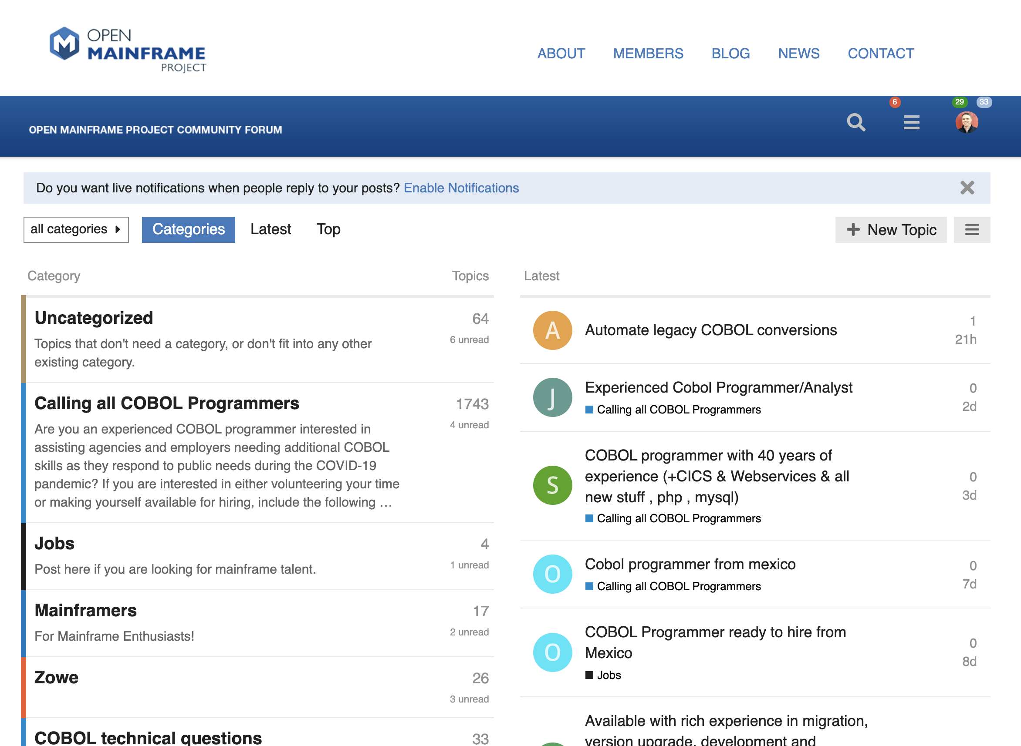


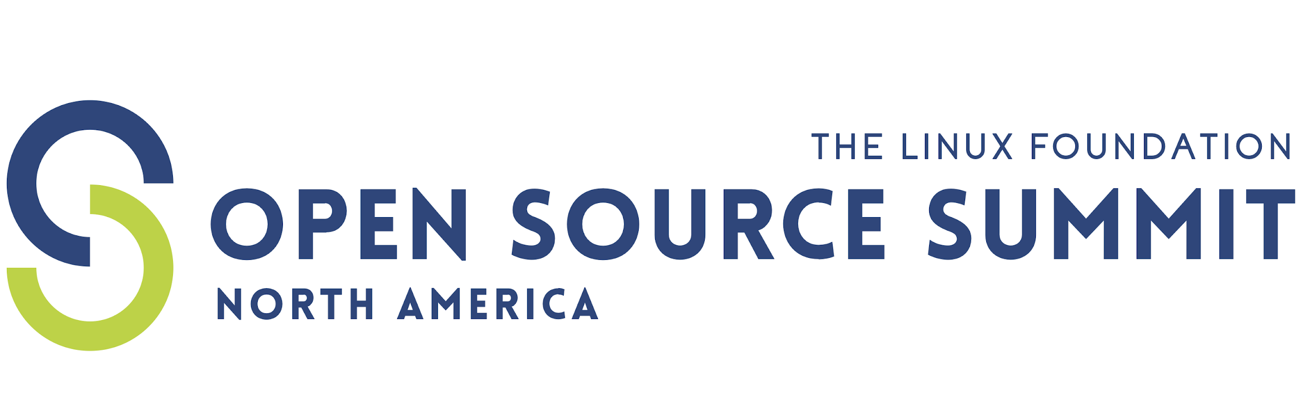
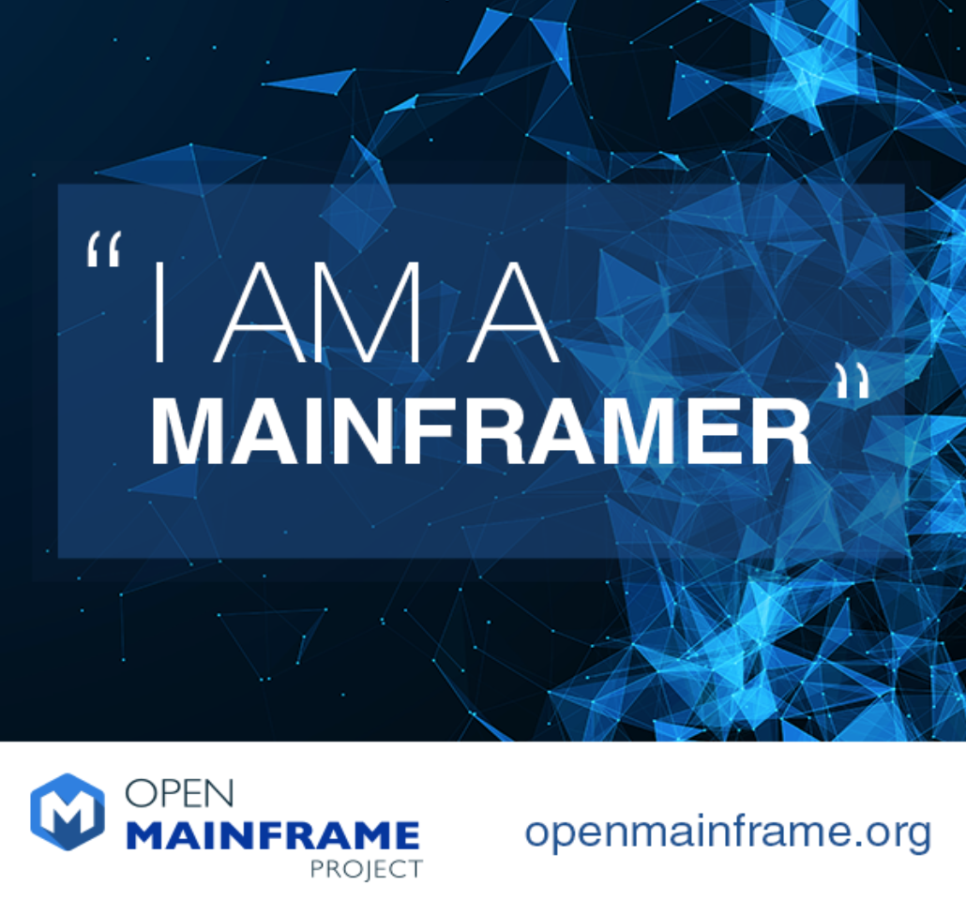
Unique opportunities for driving deeper awareness and engagement
Slack Channel
https://slack.openmainframeproject.org
Community Forums
https://community.openmainframeproject.org/
Monthly interview series that highlights diversity in mainframe
Showcases why people have mainframe in their careers and their views of the technology and career field
Read and listen at https://www.openmainframeproject.org/news/podcast
...and more!

Slide 22
Bringing your project here

Slide 23
Anna Karenina Principle of Open Source
https://en.wikipedia.org/wiki/Anna_Karenina_principle
All happy open source projects are alike; each unhappy open source project is unhappy in its own way…
The “LF Way” is that there is no one way...
The LF assumes that each open source project is unhappy/different in its own way and that leads to building a unique governance and solution to sustain their communities...

Slide 24
Basic requirements for hosting a project at Open Mainframe Project
The project must:
use an approved OSI open source license, preferably inline with the Open Mainframe Project IP Policy;
be supported by a TAC member;
allow neutral ownership of project assets such as a trademark, domain or GitHub account (the community can define rules and manage them);
technical do-ocracy and separation of business governance from technical governance (we're flexible on the model) clearly documented in a charter;
allow anyone to participate in the technical community, whether or not a financial member or supporter of the project
Often projects are new open source project, but that isn’t a requirement - existing projects are welcome!

Slide 25
Project Preparation Checklist
Prepare draft mission and scope statement
Identify internal teams within mission and scope
Identify developers internally
Analyze code for identification of licenses, license quality and project dependencies
Assess potential universe of project participants
Identify ecosystem constituents and concerns of each
Identify any trademarks leveraged by the project (these will be owned by the LF neutrally)
Outline infrastructure, marketing any other requirements needed for the project
Complete the project proposal and submit to the TAC for consideration
The Open Mainframe Project staff is happy to engage and advise during this process - let us know how we can help!

Slide 26
Project Trademarks
Our project communities control the name of the project, not any one member or company contributor
In order to provide for neutral ownership of project assets, we require that The Linux Foundation entities own the trademarks leveraged by the project.
In the event that a trademark is already in use by the sponsoring organization, we recommend that the project create a new name to operate under or the owner assign the interest in the mark to The Linux Foundation.
See http://fossmarks.org for an education on trademarks in open source

Slide 27


Learn more about the Open Mainframe Project
Find out more and subscribe to our newsletter at www.openmainframeproject.org
Discover any of our 15 hosted projects and working groups at https://www.openmainframeproject.org/projects
Organizational membership opportunities at https://www.openmainframeproject.org/about/join or email at membership@openmainframeproject.com
If you are ready to pursue corporate members, complete the paperwork at https://joinnow.openmainframeproject.org

Slide 28
Thank you!

